Slide 1
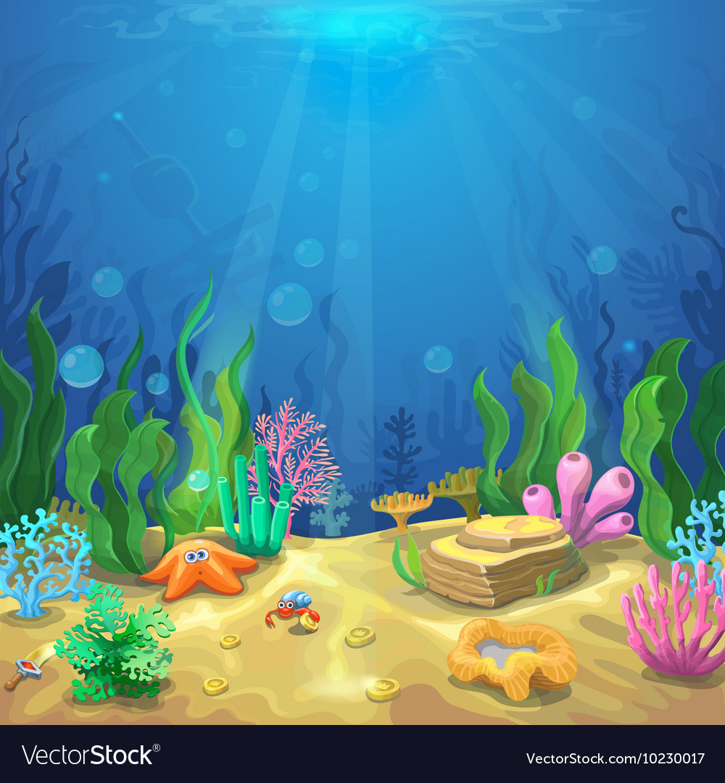
A PRESENTATION ON ANIMAL BEHAVIOUR

Slide 2
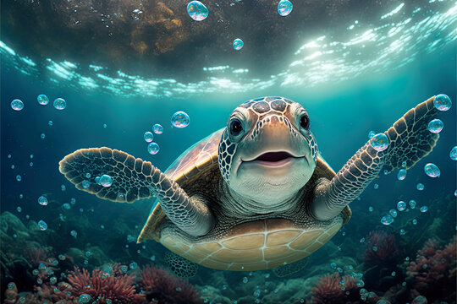
LIFE OF A GREEN SEA TURTLE
- By riya mondal

Slide 3
Green sea turtle
The Green Sea Turtle is one of the largest sea turtle and the only herbivore among the different species. Green turtles are in fact named for the Greenish colour of their cartilage and fat, not their shells. Its range extends through out tropical and subtropical seas around the world, with two distinct populations in the Atlantic and pacific oceans , but it is also found in the Indian ocean.
Globally the largest populations of sea turtles are in the Great barrier reef in Australia , and the Caribbean sea.
The common name refers to the usually green fat found beneath its carapace , not to the colour of its carapace , which is olive to black.

Slide 4
About the green sea turtle………
THE COMMON NAME : Green sea turtle or black turtle and also it’s called pacific green turtle .
THE SCIENTIFIC NAME : Chelonia mydas.
SYSTEMATIC POSITION (According to young,1981) Kingdom : Animalia
Phylum : Chordata
Class : Reptilia
Order : Testudines
Family : Cheloniidae
Genus : Chelonia
Species : Chelonia mydas
Binomial name : Chelonia mydas [By Linnaeus,1758]

Slide 5
Then we will discuss about their behaviour
Green sea turtles move across three habited types, depending on their life stage. They are generally solitary creatures that remain submerged for much of the time they are at sea . Which makes them extremely difficult to study . They rarely interact with one another outside of courtship and mating . Ridleys , however do come together in massive groups during nesting .
when they are in group………..
Green sea turtles are considered solitary , but occasionally form feeding aggregation in shallow waters abundant in seagrass or algae . The coral reefs provides red , brown, and green algae for their diet and give protection from predators and rough storms within the ocean . The salt marshes and seagrass beds contain seaweed and grass vegetation , allowing ample habited for the sea turtle . Newly emerged hatchlings are carnivorous . In contrast , immature juveniles and adults are commonly founding seagrass meadows closer inshore as herbivorous grazers.

Slide 6
Feeding behaviour of a green sea turtle
Adult green sea turtles are herbivores . The jaw is serrated to help the turtle easily chew its primary food source seagrasses and algae . Juvenile green sea turtles are omnivores . They eat a wide variety of plant and animal life , including insects , crustaceans , seagrasses and worms.
Young sea turtles eat fish and their eggs , sea hare eggs , molluscs , jelly fish , small invertebrates , insects , worms , sponges, tree bark, leaves .They have a relatively slow growth rate because of the low nutritional value of their diet. Body fat turns green because of the consumed vegetation.
Green turtle have a hindgut fermentation digestive tract , which uses cellulolytic microbes to brake down plant matter in the cecum and proximal colon .

Slide 7
Breeding behaviour of the sea turtle ( life cycle )
The breeding season occurs in late spring and early summer . The males arrive in offshore waters first and wait for the females to come to the beaches. Adult males can breed every year , but females only breed every three to four years .
A few weeks after mating a female green sea turtles arrives on the beach and digs the whole in the sand for her eggs . Inside the whole , she leys 75 to 200 eggs and covers the whole with sand . At this point , her role is complete and she leaves her eggs to fend for themselves. A female green sea turtle can lay several clutches of eggs before she leaves the nesting ground.
After about two months, the eggs hatch and the hatchlings make their to the water . The newly hatched green sea turtles are very susceptible to predators , exposure , and losing their way .

Slide 8
GREEN SEA TURTLE : IMPORTENSE TO HUMANS
Historically , the turtles skin was tanned and used to make handbags , especially in Hawaii. Ancient Chinese considered the flesh of sea turtles a culinary delicacy , including and especially C . mydas . Particularly for this species , the turtle’s fat , cartilage , and flesh , known as calipee, are sought as ingredients for making turtle soup , a popular 19th century English and American dish.

Slide 9
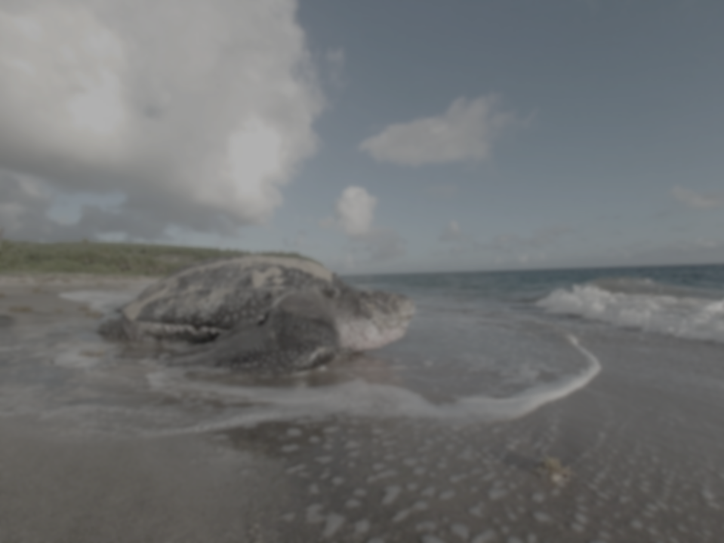
Conservation of green sea turtle
“SEA TURTLES HAVE POPULATE EARTH’S OCEANS FOR MORE THAN 100 MILLION YEARS”
Green sea turtles are an endangered species that have undergone an estimated 90% population decrease over the past half century .
Climate change and habited lose are threats to this animals , as well ass diseases such as fibropapilloma . Light population near beach nesting sites poses risk to sea turtle hatch lings , which may get confused and crawl toward the light instead of traveling to the ocean.
The biggest threats to sea turtles are illegal harvesting, habitat encroachment, and pollution are only some of the things sea turtles must fight against to stay alive.

Slide 10
If we want, we can save the green sea turtle …..
The major recovery actions for green turtles include : protecting seas turtles on nesting beaches and in marine environments protecting nesting and foraging habitats . Reducing buy catching commercial, artisanal, and recreational fisheries.
Keep nesting beaches dark and safe at night. Turn off shield ,redirect light visible from the beach-lights disorient hatch lings and discourage nesting females from coming on to beaches to lay their eggs.
After a day at the beach, remove recreational beach equipment like chairs & umbrellas so sea turtles are not entrapped or turns away .
Do not drive on sea turtle nesting beaches.
Thank you

